Slide 1
World Happiness Scores
By: Jon Scheaffer, Alvin Ugochukwu, and Sam Sharp

Slide 2
Data Source and Explanations
World Happiness Score is the output that is obtained when statistically calculated from many different variables which describe aspects of society in a given country.
The dataset used is from the World Gallup Poll.
Importantly, none of the predictor variables appear to be collinear, which strengthens the argument for the use of multiple linear regression.
The dataset consists of entries for 146 countries, using 6 predictors that each linearly correlate with the World Happiness Score.
The data can be found at: https://www.kaggle.com/datasets/ajaypalsinghlo/world-happiness-report-2022

Slide 3
Variables and Their Meanings
The following chart explains the variables analyzed (each variable has a maximum value of 10):
Variable Name | Abbv. | Meaning
World Happiness Score | hs | Happiness score, the predicted result from independent variables
GDP per capita | gdp | The GDP of the country in question
Social support | soc | The level of social programs and support available
Healthy life expectancy | hle | The healthy life expectancy of a person in the country
Freedom to make life choices | free | The ability of a person in the country to do what they wish
Generosity | gene | The level of generosity someone experiences in the country
Perceptions of corruption | poc | The level of perceived corruption within institutions of power

Slide 4
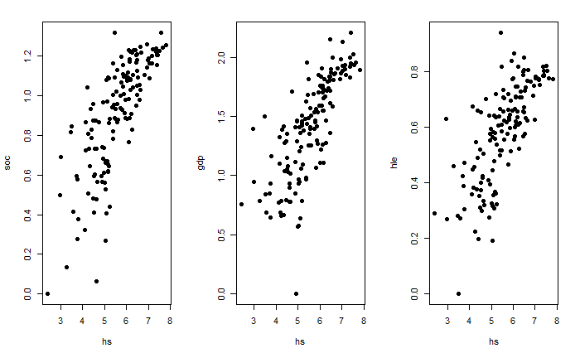
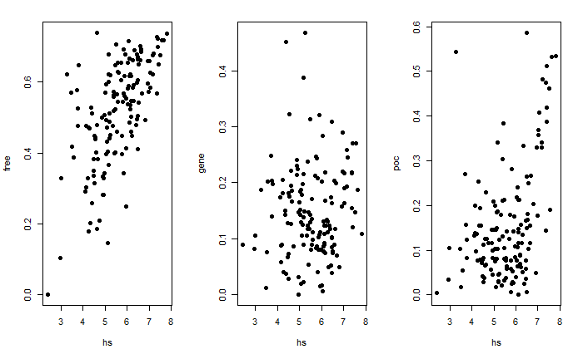
Preliminary Analysis of the Variables

Slide 5
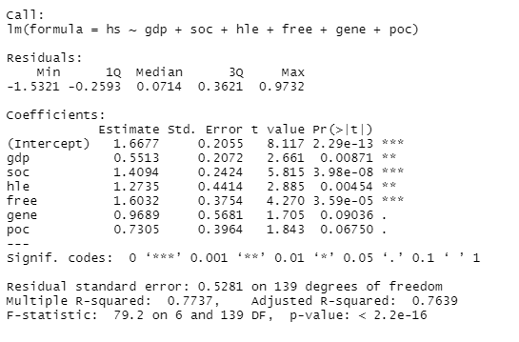
Correlation among Predictor Variables
The overall F-statistic for the data is 79.2. The p-value is 2.2e-16, which indicates that the regression model is significant.
After running a collinearity check on the different independent variables, it is important to note that they do not appear to be strongly correlated at all as none of the variance inflation factors are even greater than 4.

Slide 6
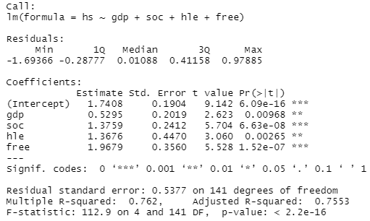

Removal of insignificant variables
As the summary of the variables states, the p-value of the data is very low. However, for the variables gene and poc, their p-values are greater than the significance level (α) = 0.05, and are thus not significant and can be omitted.
Our new summary of the variables with gene and poc omitted:
New VIF test for the remaining included variables (since gene and poc are not significant, they do not affect these values very much):
While the multiple R² and adjusted R² with the original variables was high at 0.774 and 0.764, these values with the significant variables are still high at 0.762 and 0.755.

Slide 7
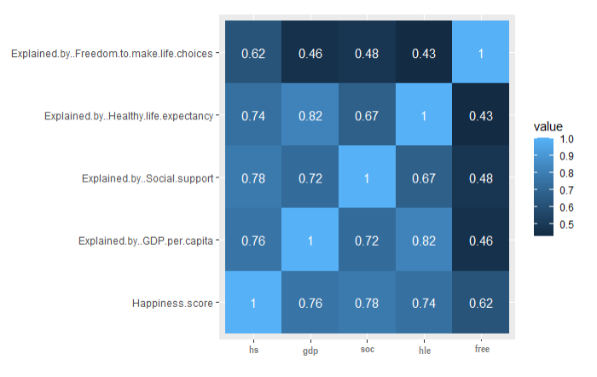
Heatmap of Independent Variable Correlation
Though some cells of the heatmap seem highly correlated with a factor of 1, this is simply due to the variable being compared to itself, which is irrelevant to the overall result.

Slide 8
Conclusions
To test the data’s resulting function for yielding an accurate result, a sample value may be used.
The equation to find a predicted happiness score is:
hs = 1.74 + (0.53)X₁ + (1.376)X₂ + (1.368)X₃ + (1.968)X₄

Slide 9
Conclusions (cont’d)
To test the formula that the data has yielded, the mean values for each variable may be used, resulting in the following equation:
hs = 1.74 + (0.53)1.41 + (1.376)0.906 + (1.368)0.586 + (1.968)0.517
If this data holds to the multiple linear regression function we have found, the expected hs value will be ~5.554. After plugging in each variable’s average and calculating the result, we get an hs value of 5.553. Since this observed value is within 0.05 of the expected value, the multiple linear regression holds.

